Slide 1

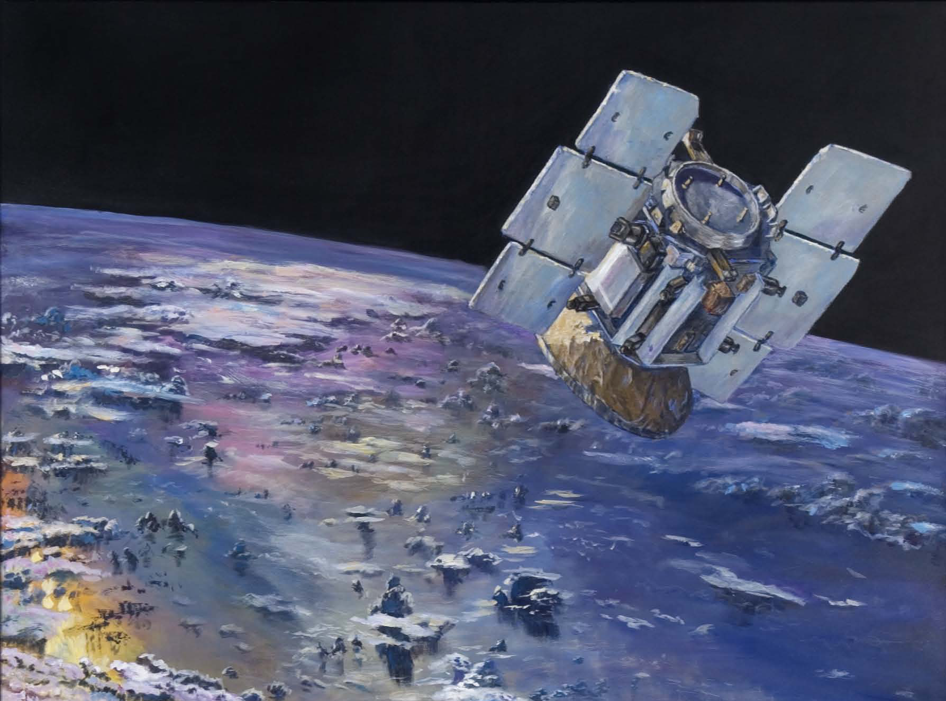
The Importance of Studying Clouds: NASA Cloud Science and its application to Classroom Science Inquiry
CloudSat
Deborah Vane
CloudSat Deputy Principal Investigator
Caltech Trustees Committee on JPL
27 April 2005
Prof. Todd Ellis
Ms. Susan Moore
Ms. Deanna TeBockhorst
Dr. Todd Ellis
Ms. Susan Moore
Ms. Deanna TeBockhorst
12 March 2011

Slide 2
Clouds in the palm of your hands…
Making a cloud in a bottle provides opportunities for a spectrum of differentiated learning activities, including:
  The difference between water vapor and cloud droplets
  Gay-Lussac’s law
  Collecting and analyzing data on a graph
  The role of Cloud Condensation Nuclei in cloud formation
  The role of temperature on relative humidity
  And more…

Slide 3
Clouds and The Water Cycle
Fresh water is less than 1% of all water on Earth
Water vapor is less than 1% of all fresh water

Slide 4
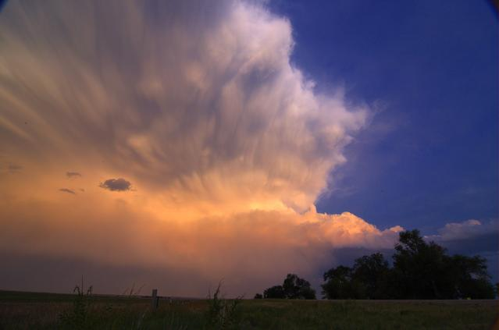
Latent Heat Release
An average thunderstorm
contains several thousand
metric tons of water
Condensing 1 kg of water
releases ~ 2260 kJ of
latent heat energy
An average thunderstorm containing around 1500 tons of water will release 3.4 million megajoules of energy
Notes:
SF uses avg rat 750 MW (MJ/sec) – 1.25 hrs

Slide 5
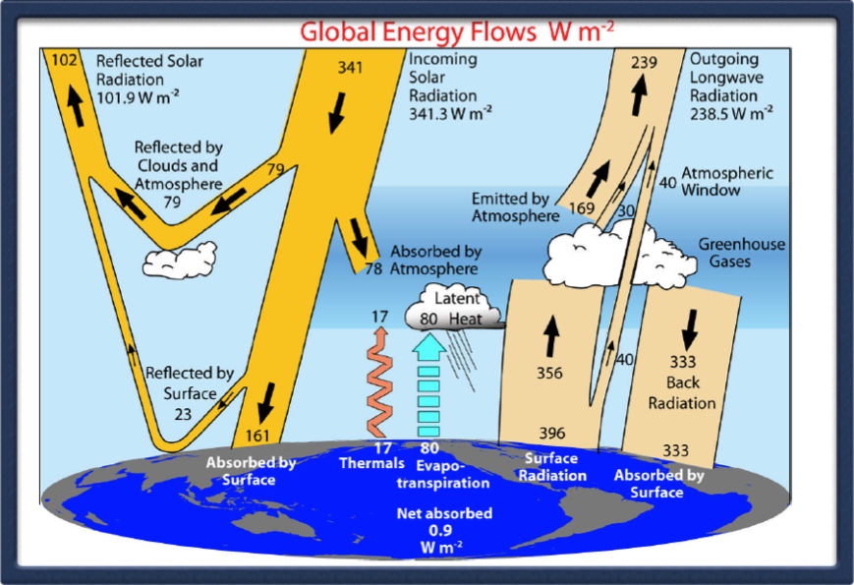
The Earth’s Radiation Budget
Clouds play multiple roles in the atmosphere – which is why studying them is so important!

Slide 6
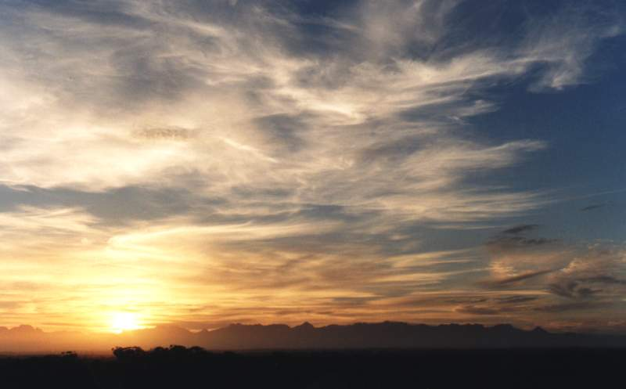

High Clouds
Thin, cold ice clouds reflect less sunlight
Extremely cold, emits infrared at colder temperatures, prevents warmer surface infrared from escaping to space
NET EFFECT: Warming

Slide 7
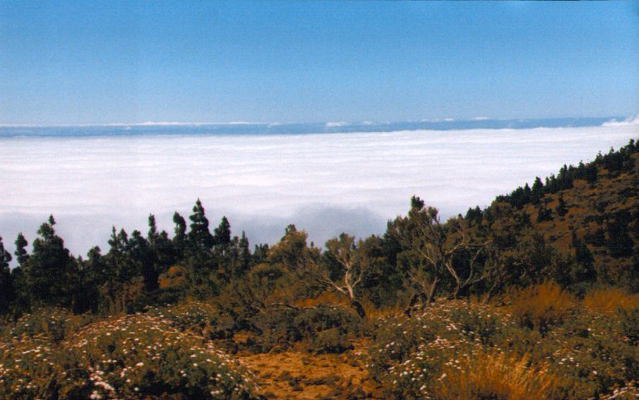
Low Clouds
Very thick water clouds reflect large amounts of sunlight
Very near the surface, temperature of the cloud effectively the same as surface. Infrared radiation is therefore about the same - almost like the cloud wasn’t there!
NET EFFECT: Cooling

Slide 8
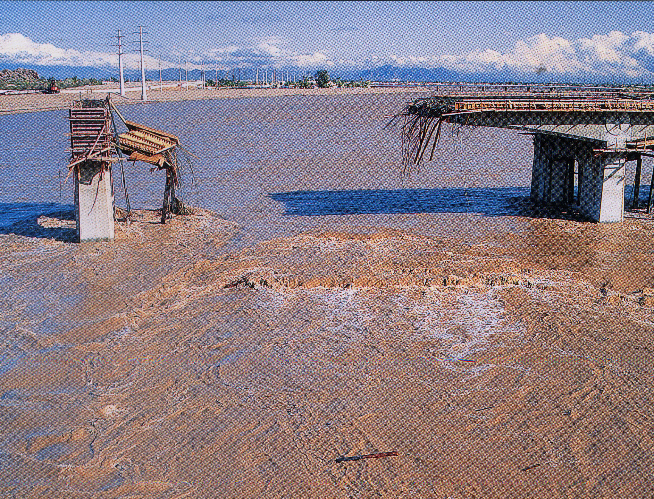
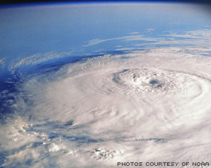

Cloud Observations can tell us:
How much rain and snow is produced, and how pollution (aerosols) might affect this process,
For all reasons that matter, it is the type of clouds that matters
How much heat is generated in the atmosphere to fuel storms,
How much sunlight is reflected to space, or how the planetary greenhouse effect is changed by clouds.

Slide 9
Identifying clouds

Slide 10
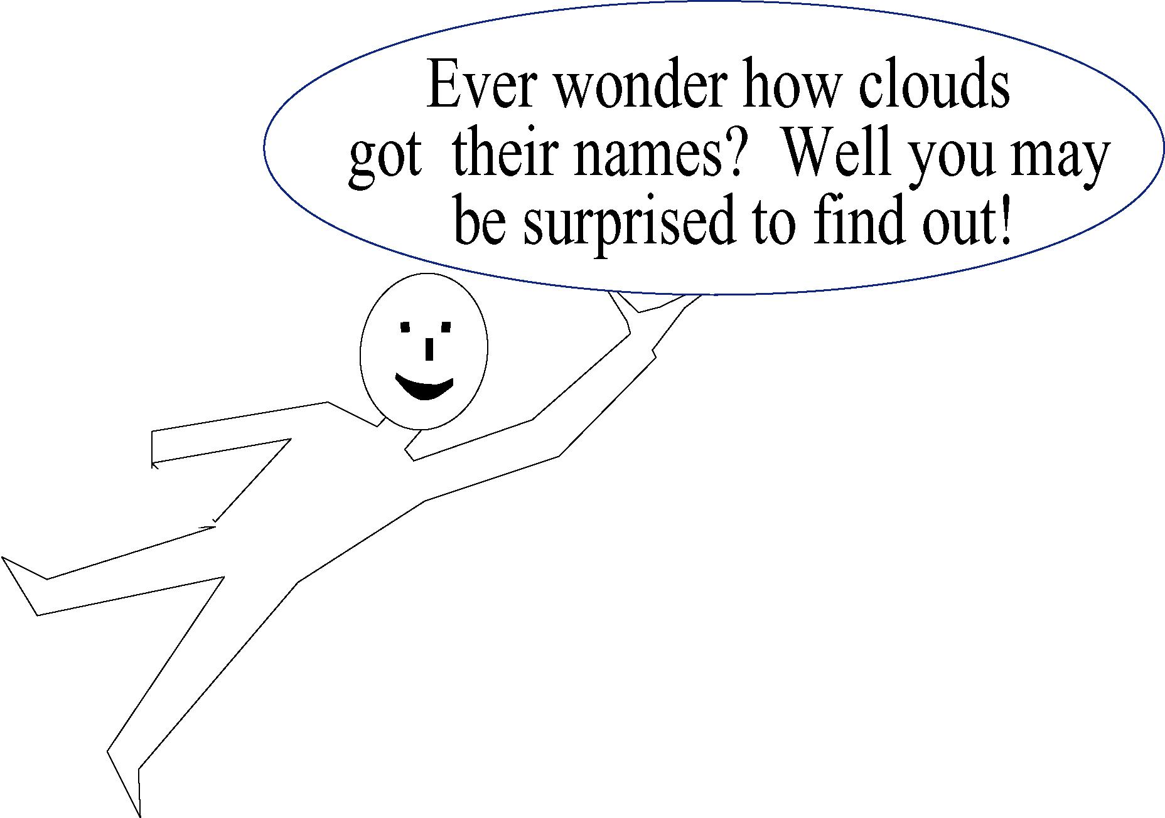
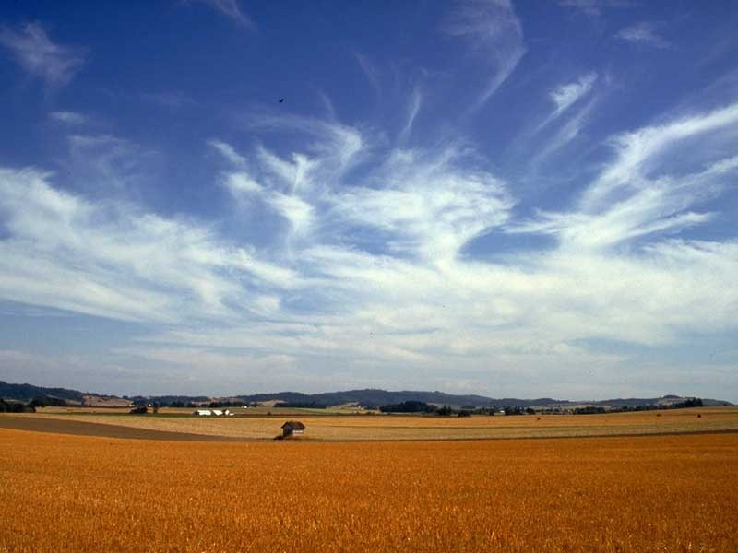
Just over 200 years ago (in 1803), Luke Howard used Latin words to name the cloud types.
Cirrus – means hair and describes wispy looking clouds.
This term is also used to describe high level clouds
Nimbus – means cloud and describes low grey rain clouds
Alto – describes mid level clouds

Slide 11
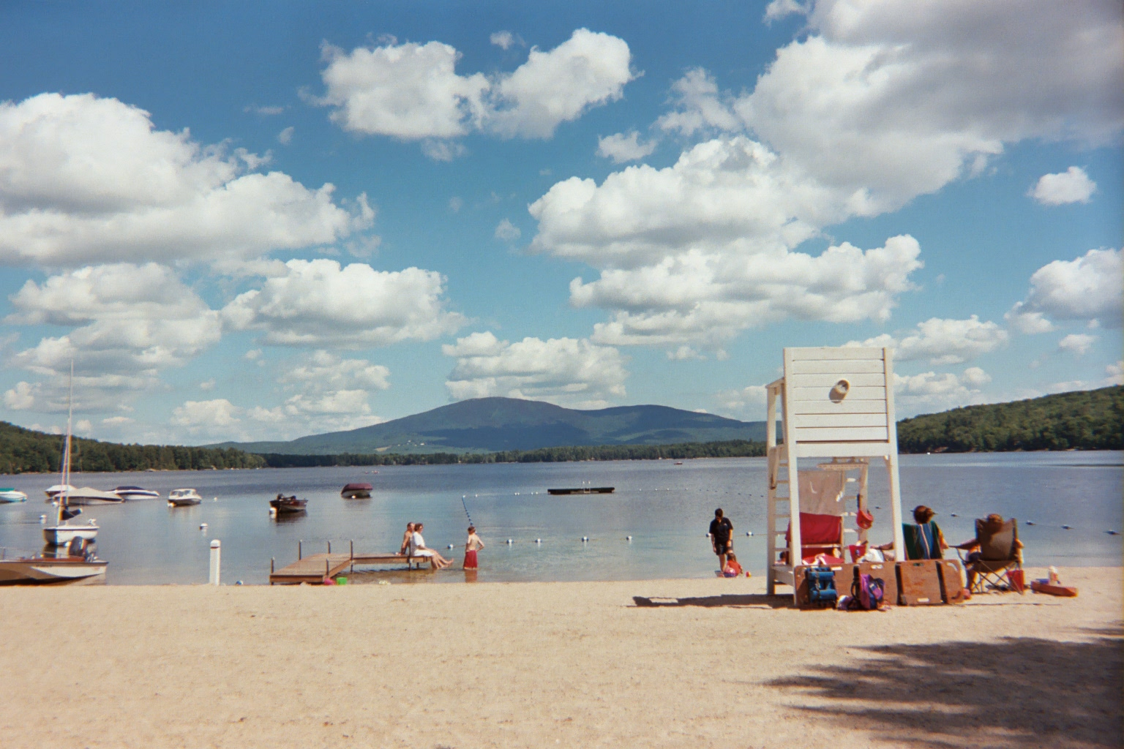
Just over 200 years ago (in 1803), Luke Howard used Latin words to name the cloud types.
Cumulus – means pile and describes heaped, lumpy clouds
Nimbus – means cloud and describes low grey rain clouds
Alto – describes mid level clouds

Slide 12
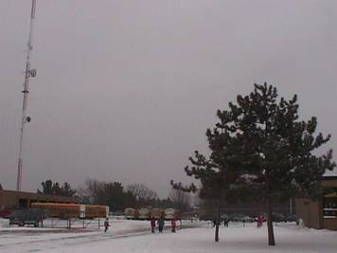
Just over 200 years ago (in 1803), Luke Howard used Latin words to name the cloud types.
Stratus – means layer and describes clouds that form in sheets and do not have any unique features
Nimbus – means cloud and describes low grey rain clouds
Alto – describes mid level clouds

Slide 13
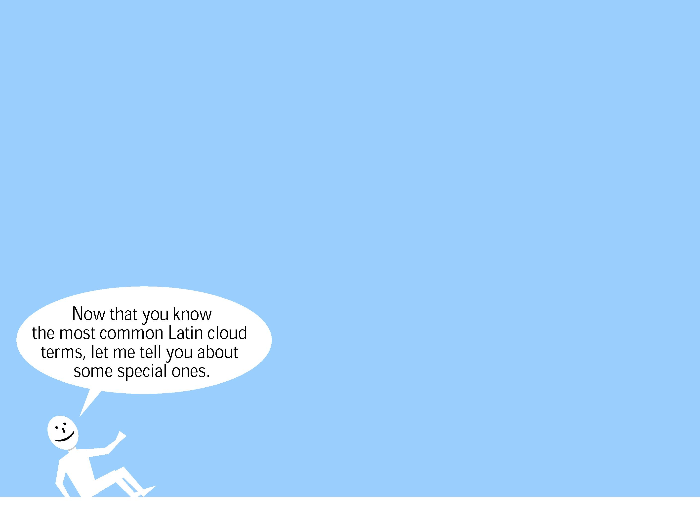
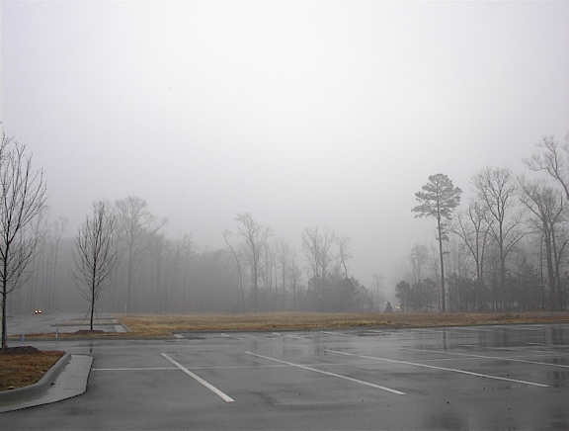
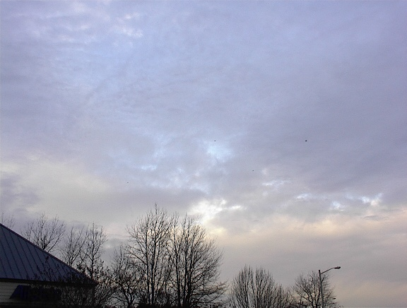
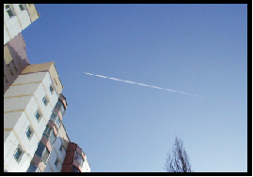
Cumulus – lumpy Cirrus – wispy Stratus - layered
Special Cloud Terms
Nimbus – means rain and describes low grey rain clouds
Alto – describes mid level clouds
Contrails – short for ‘condensation trails’ are the only man-made cloud

Slide 14
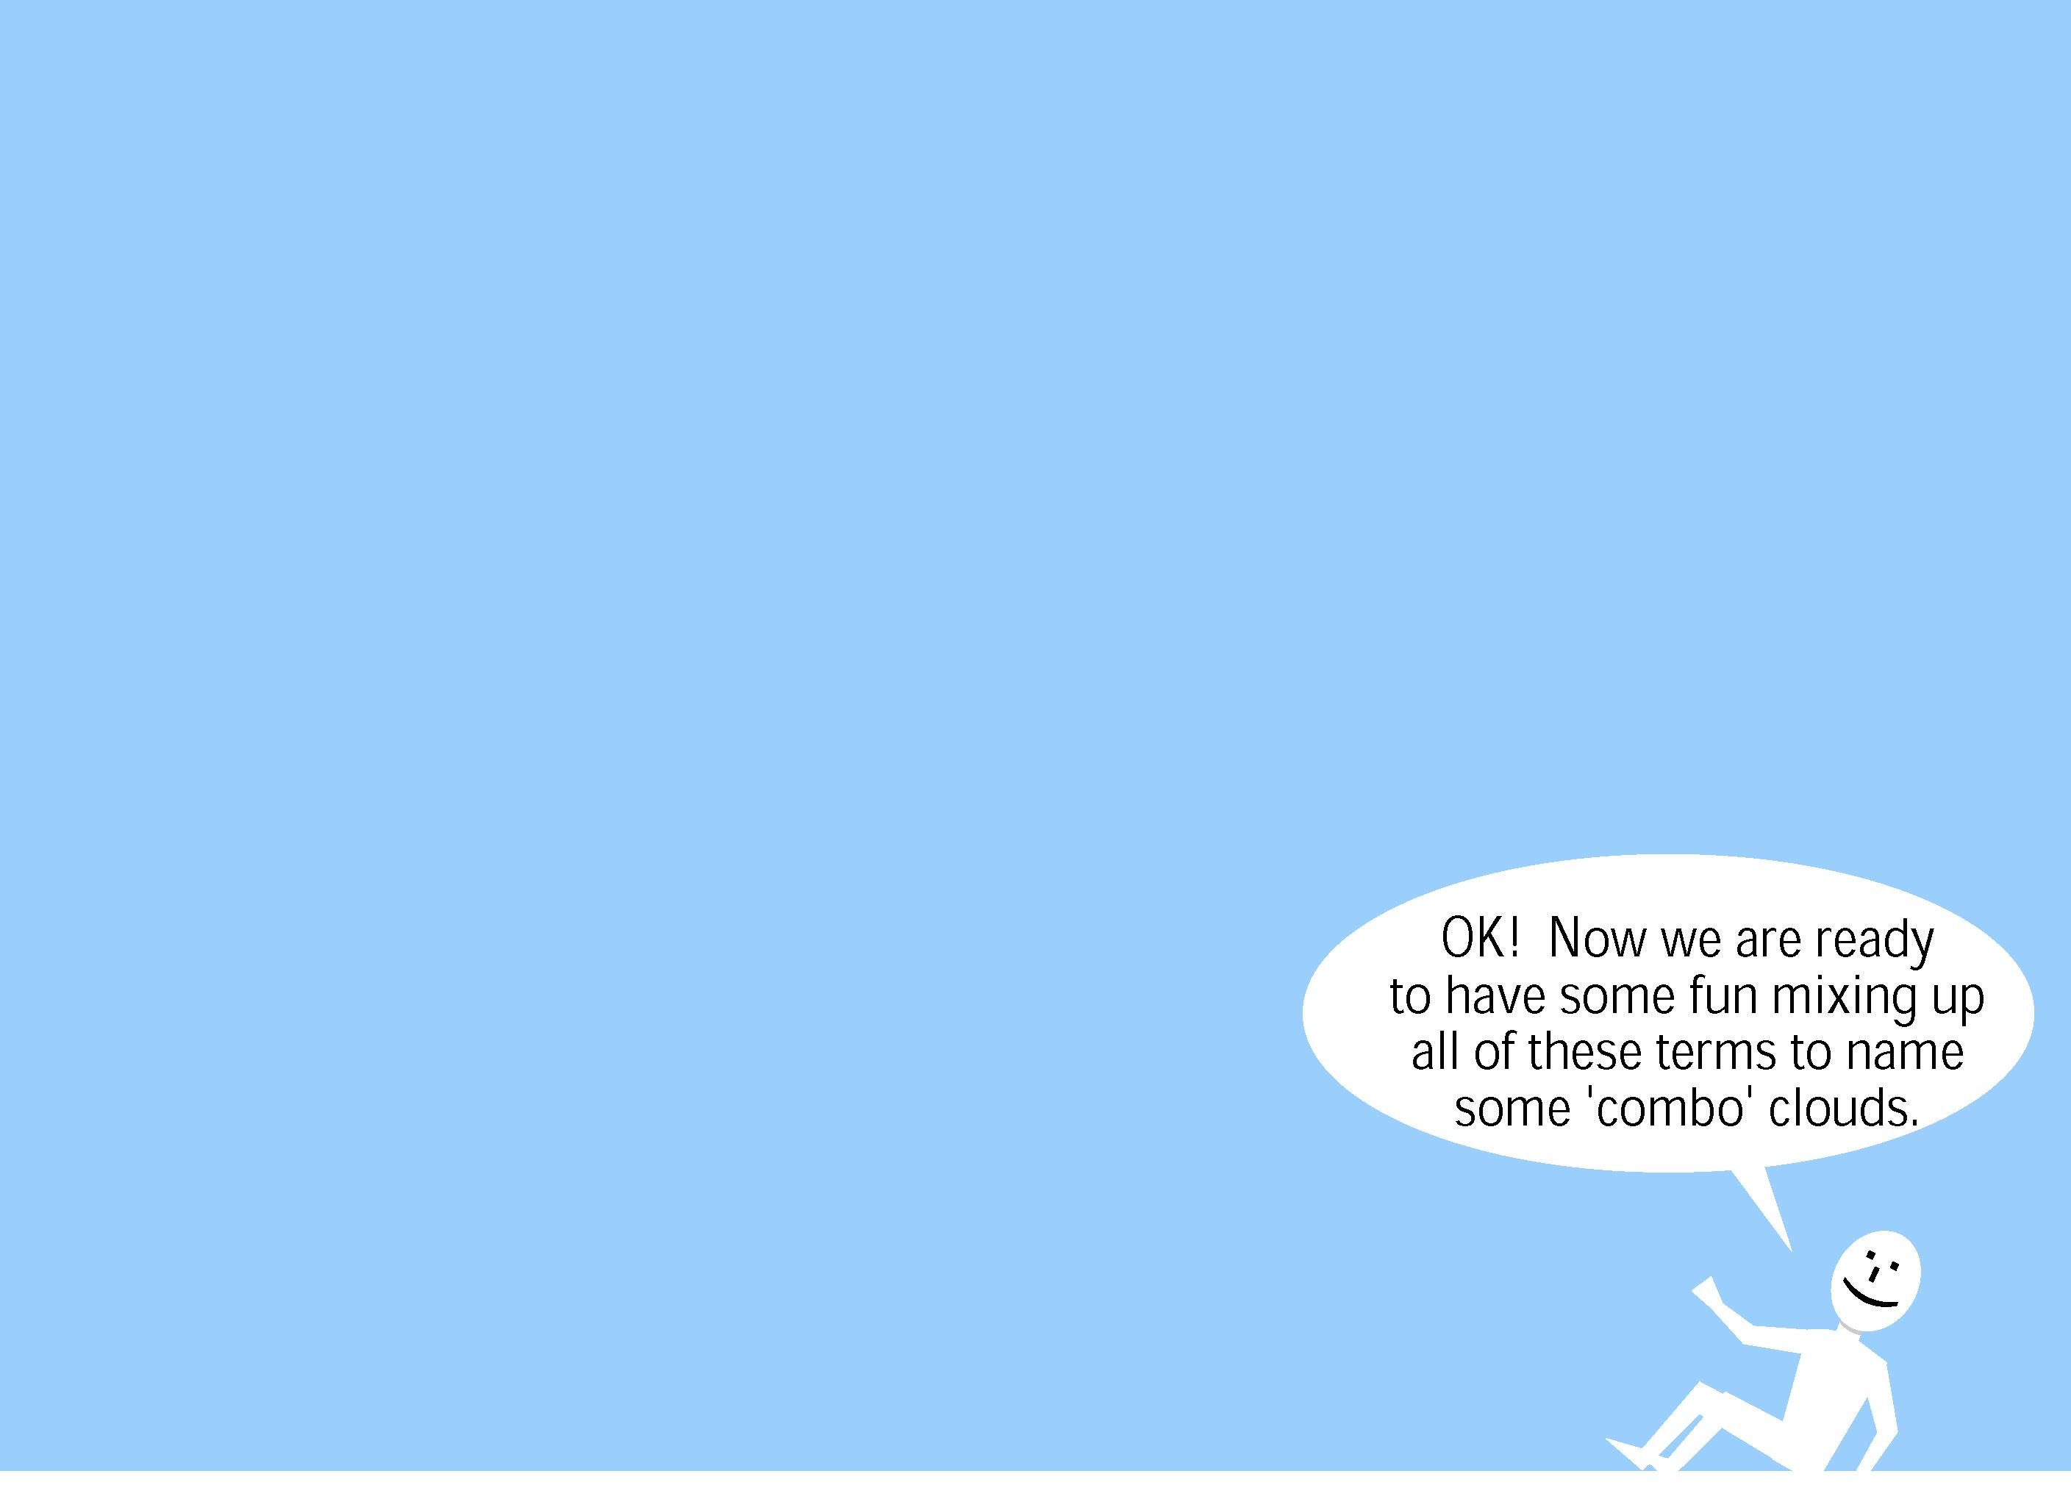
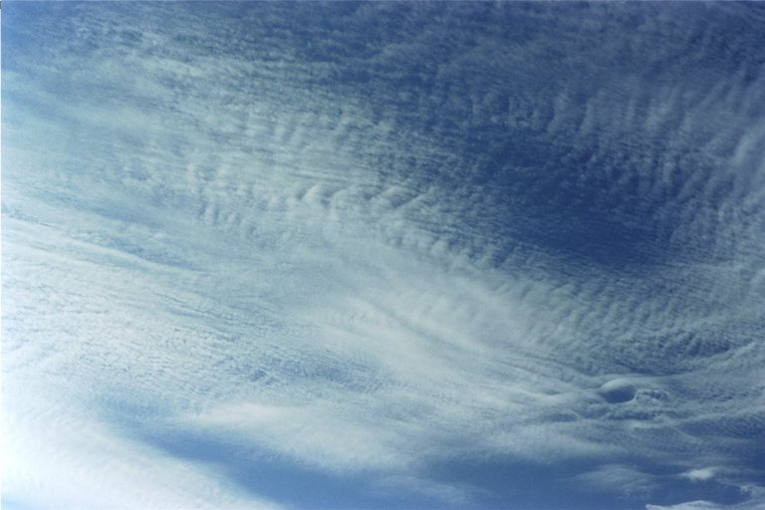
Cumulus – lumpy Cirrus – wispy Stratus – layered
Nimbus – raining Alto – mid-level Contrails - streaks
Name Combinations
Cirrocumulus

Slide 15
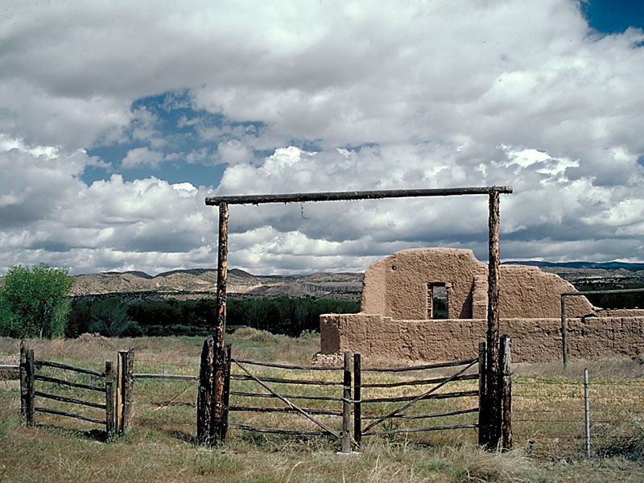
Cumulus – lumpy Cirrus – wispy Stratus – layered
Nimbus – raining Alto – mid-level Contrails - streaks
Name Combinations
Stratocumulus

Slide 16
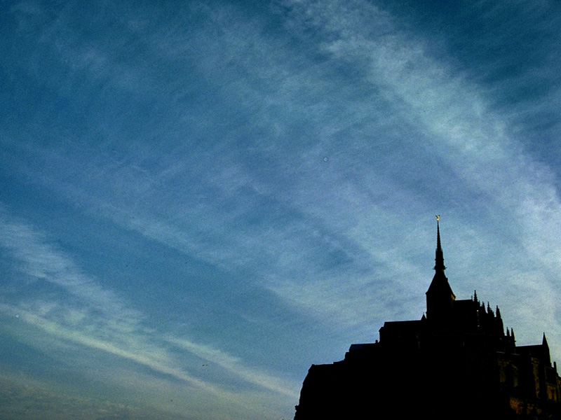
Cumulus – lumpy Cirrus – wispy Stratus – layered
Nimbus – raining Alto – mid-level Contrails - streaks
Name Combinations
Cirrostratus

Slide 17
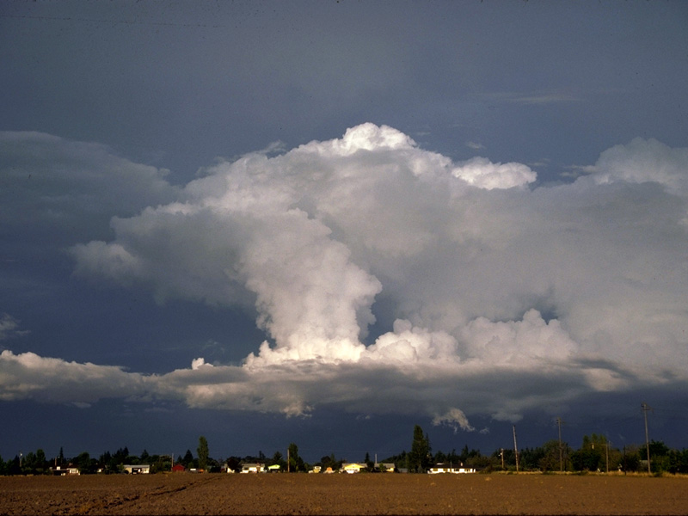
Cumulus – lumpy Cirrus – wispy Stratus – layered
Nimbus – raining Alto – mid-level Contrails - streaks
Name Combinations
Cumulonimbus

Slide 18
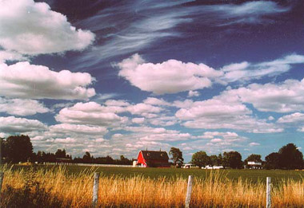
So How do We Determine Cloud Cover?

Slide 19
Activity Time!
Cloud Identification Activity
Cloud Cover Estimation Activity
When working on these activities:
  Think about how many different ways you can use them
  Consider how they can be used to support inquiry (data collection, data analysis, asking answerable questions)
  Ask questions of us as we work with you

Slide 20
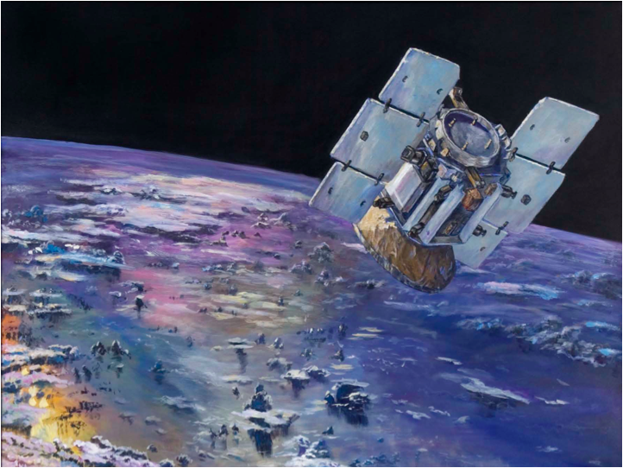
CloudSat - A View Into the Clouds
CloudSat is a Spaceborne cloud penetrating radar tuned so that clouds reflect energy based on the amount of condensed/frozen water in the cloud
Gives us the first global look at the structure and life cycle of clouds of all types

Slide 21
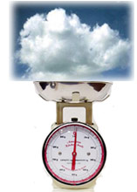
A special kind of radar - one that weighs the water in clouds
CloudSat’s great sensitivity allows us to see clouds and any related precipitation.

Slide 22
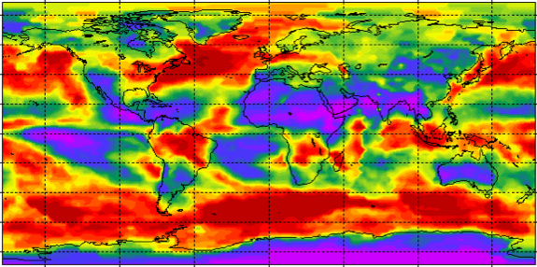

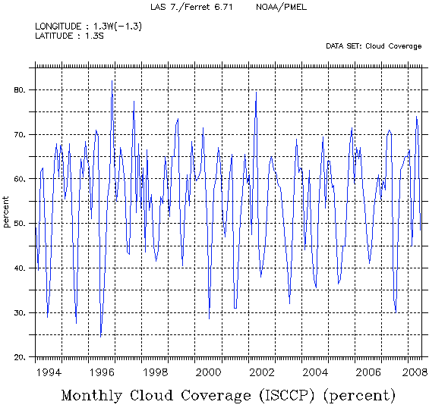
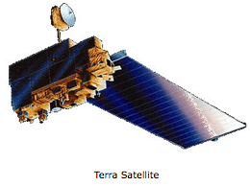
Cloud data & Inquiry learning
    Using data
Gathering data
Storing data

Slide 23
Cloud data & Inquiry learning
Student cloud observation, data-collection, and analysis, such as GLOBE, CloudSat, and S’COOL
Satellite “remote” observation and data-collection with student data-analysis, such as MY NASA DATA

Slide 24
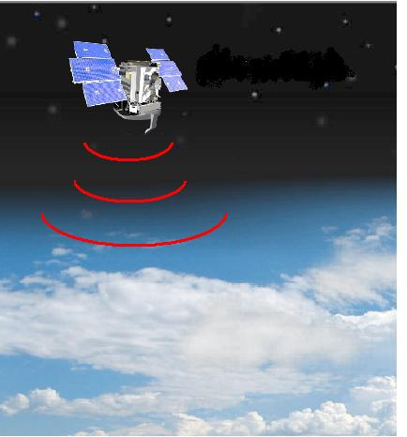
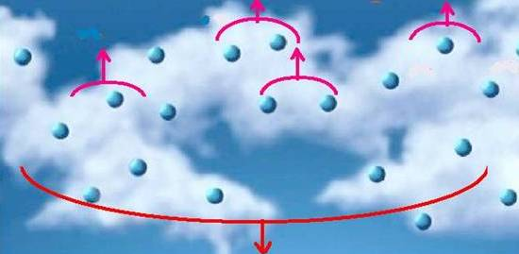
How the CloudSat Radar Works
As CloudSat orbits Earth, it transmits short pulses of microwave energy down into the Earth’s atmosphere.
The CloudSat radar measures the time delay and magnitude of the reflected signal
A fraction of these pulses reflect off of cloud particles and bounce back to the satellite.
Other pulses continue downward

Slide 25
The CloudSat mission, weighing clouds
The strength of the returned signal indicates the amount of condensed water/ice in clouds - that is the radar provides us with a way of weighing the water in clouds

Slide 26
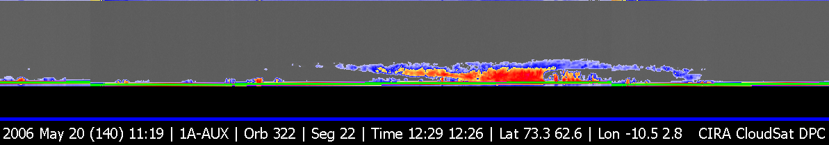
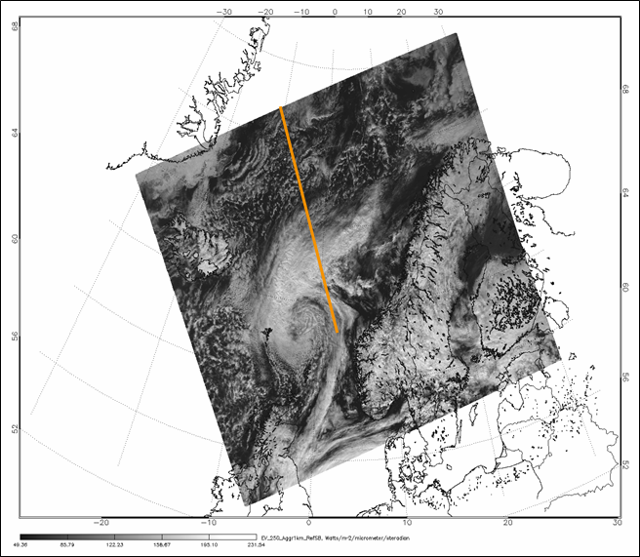
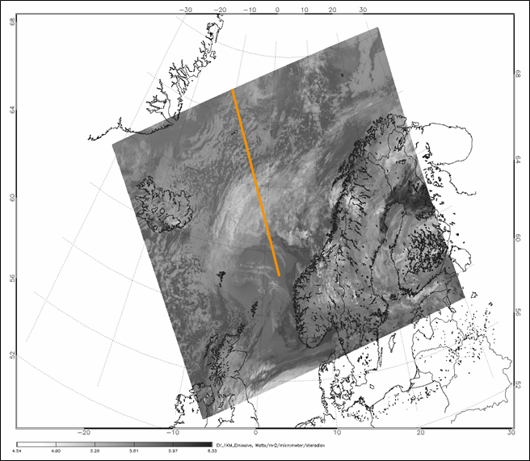
“FIRST IMAGE”
This segment was the first ever CloudSat data - 20 May 2006 12:26-12:29 UTC
B
A
B
B
A
A
MODIS Visible
MODIS Infrared

Slide 27
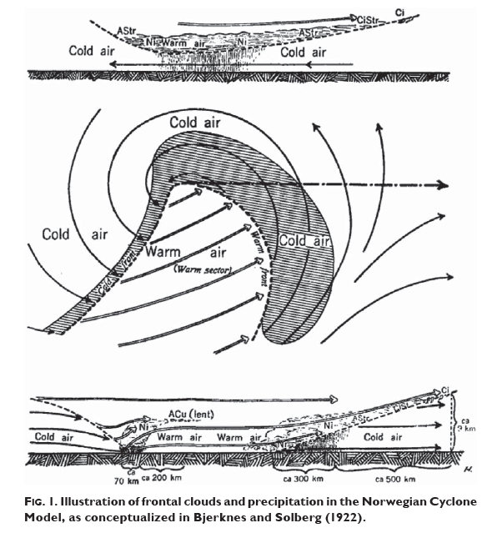
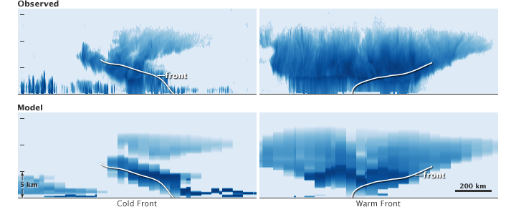

Slide 28
There are many hurricane overpasses on the CloudSat website, in addition you’ll find:
educational resources about clouds
connections between clouds and art
ways to access looks at the clouds over your school from CloudSat.

Slide 29
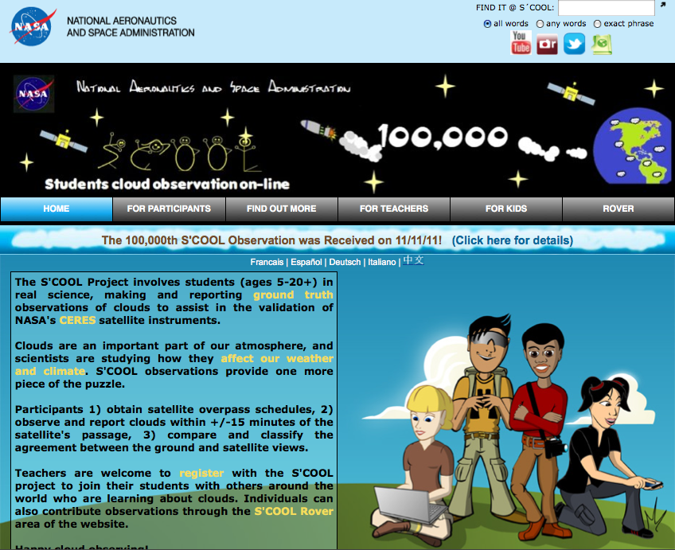

Slide 30
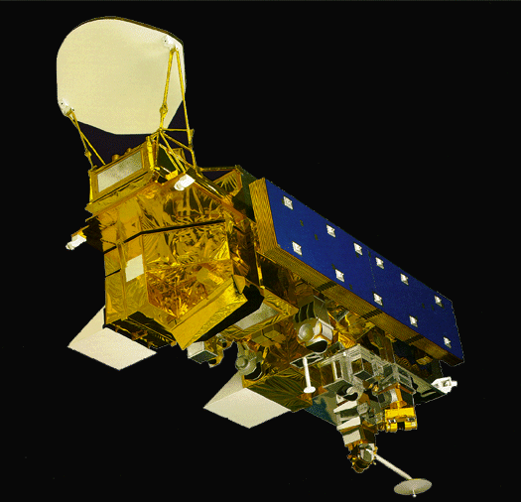
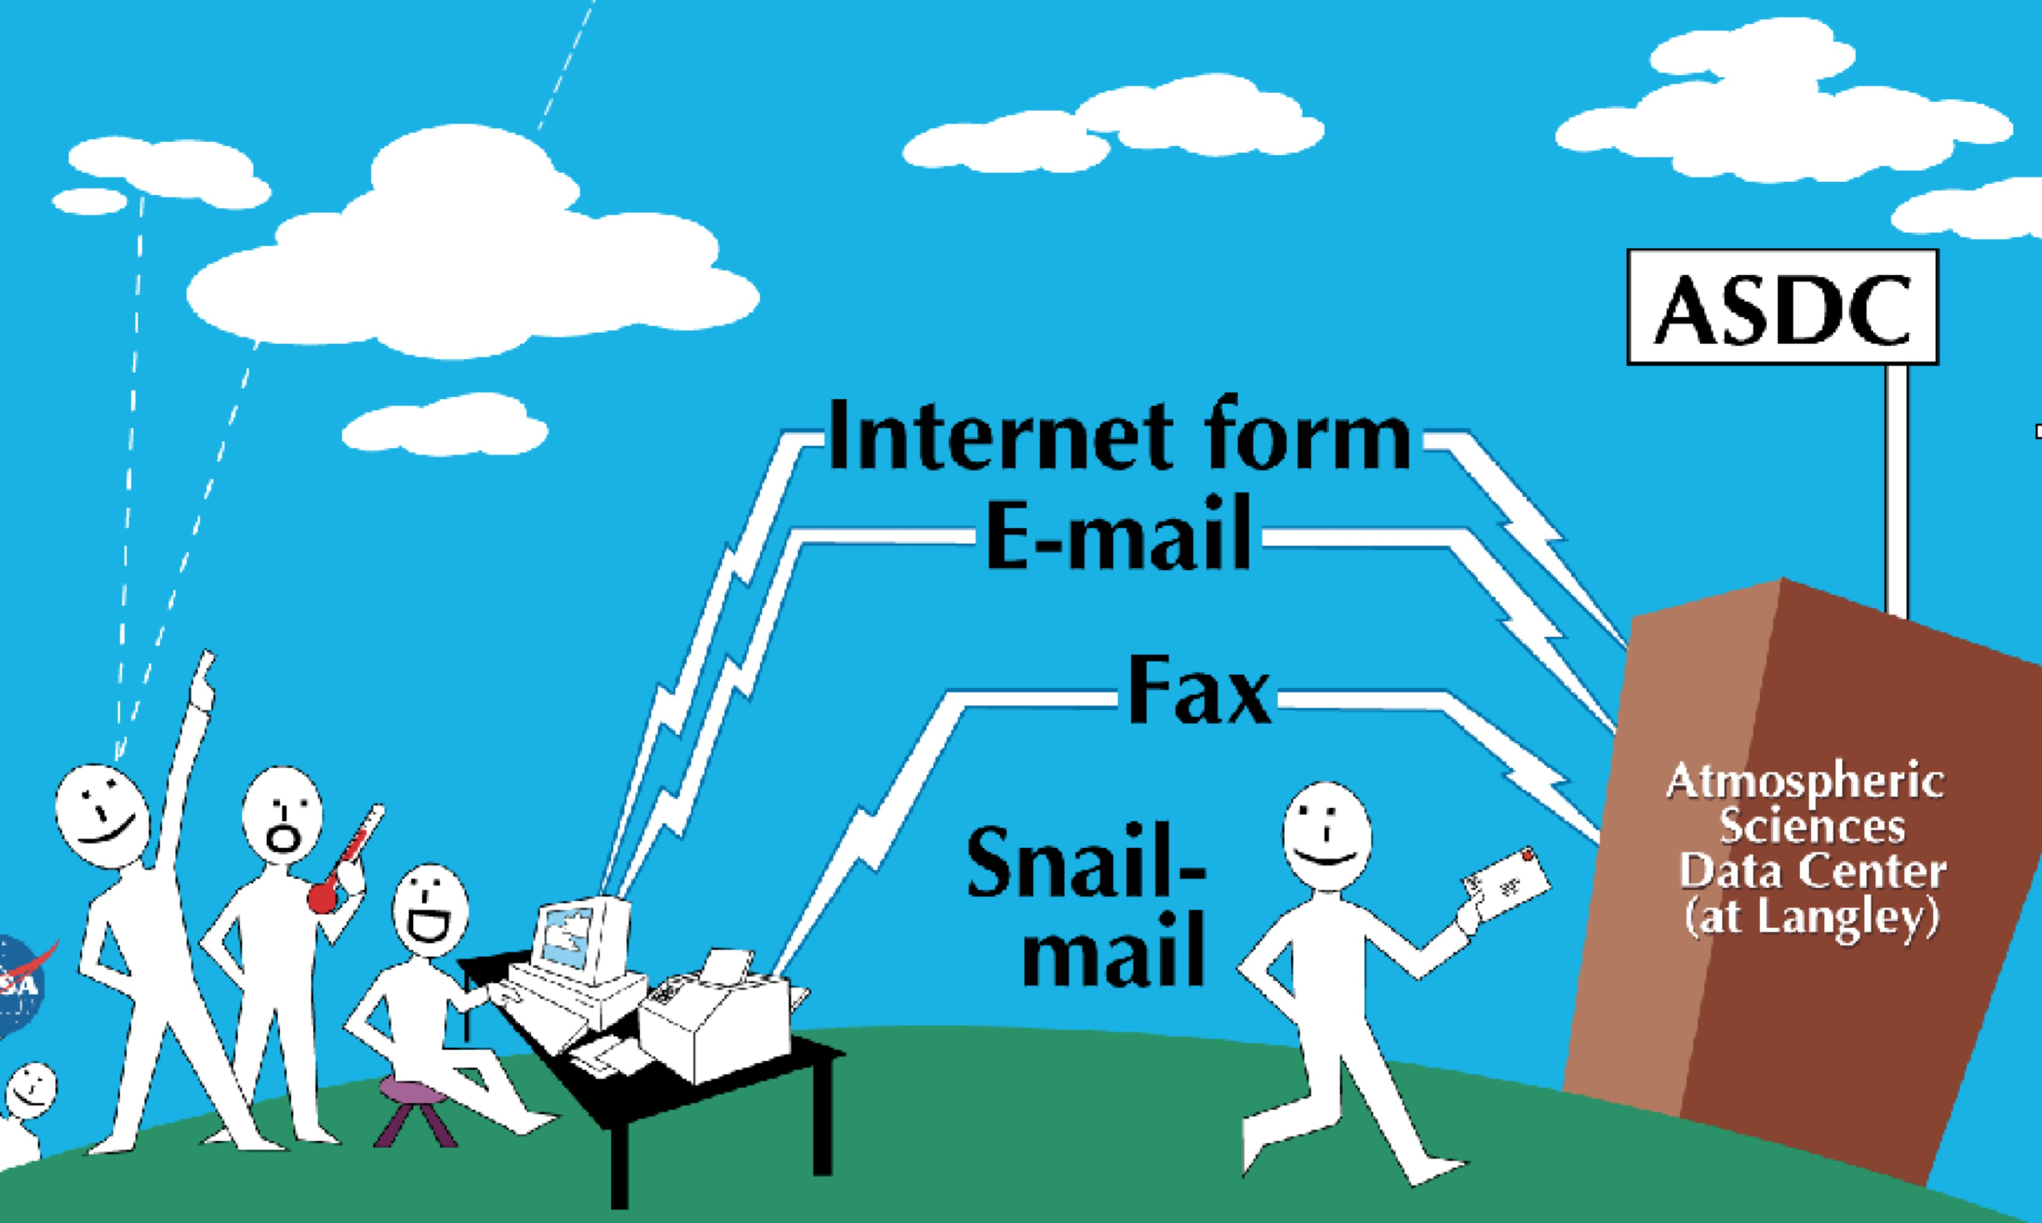
The S’COOL Project
Students provide ground observations for a satellite overpass
        Determine satellite overpass time
        Observe cloud properties
        Transmit results to NASA
        Compare to satellite-retrieved properties
Data of value to scientists
(i.e., Chambers et al, 2004, Shiffman, 2005)
Real-world learning for students

Slide 31
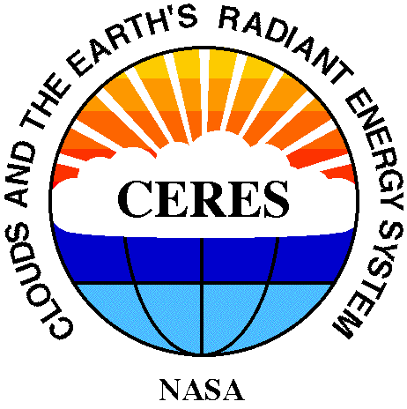
NASA has a science project!
The name
of this
science experiment
is

Slide 32
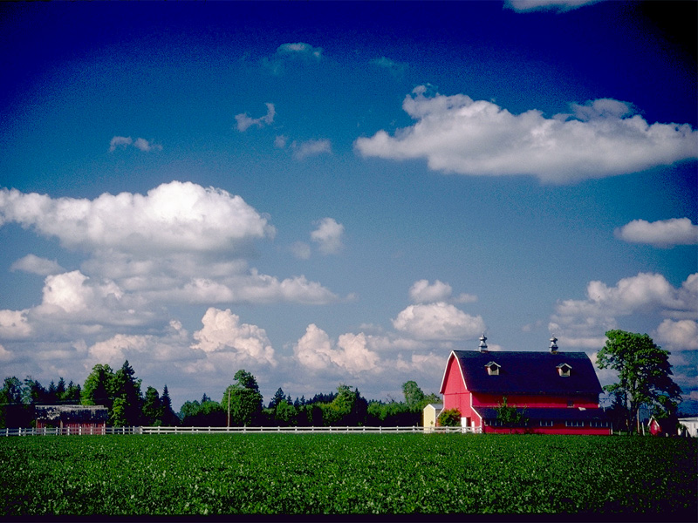
The CERES Experiment:
Question:
What is the Effect of Clouds on the Earth’s Climate?

Slide 33
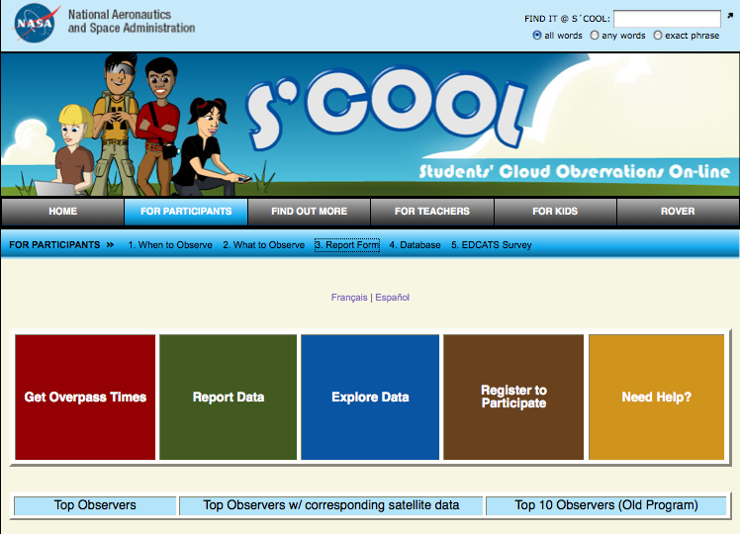

Slide 34
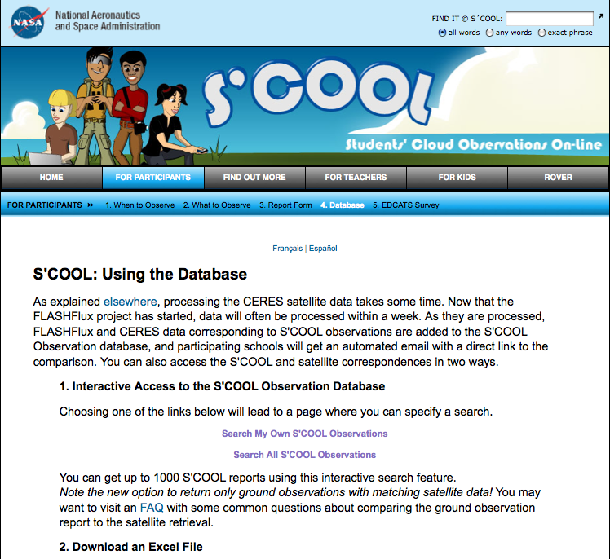

Slide 35
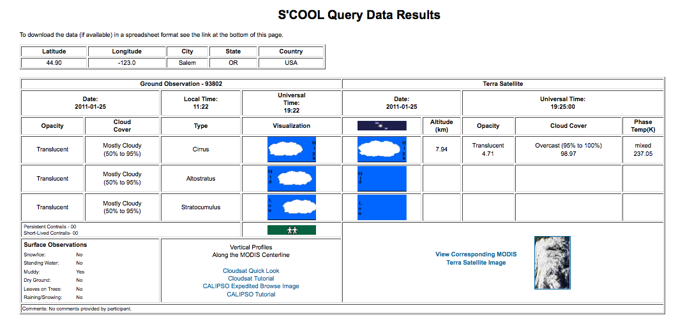

Slide 36
Compare to other satellites
CERES on Terra
MODIS on Terra

Slide 37
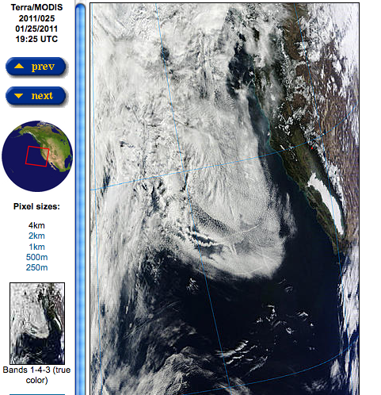
Compare to other satellites
Look at the “big picture”
MODIS on Terra

Slide 38
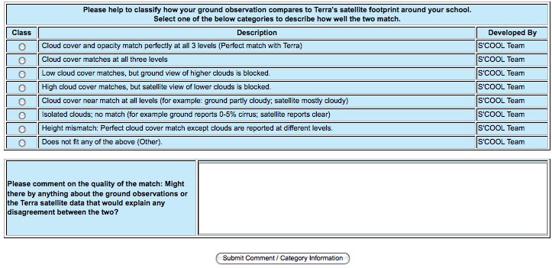
Analyze agreement/disagreement
Classification
Free-response comments

Slide 39
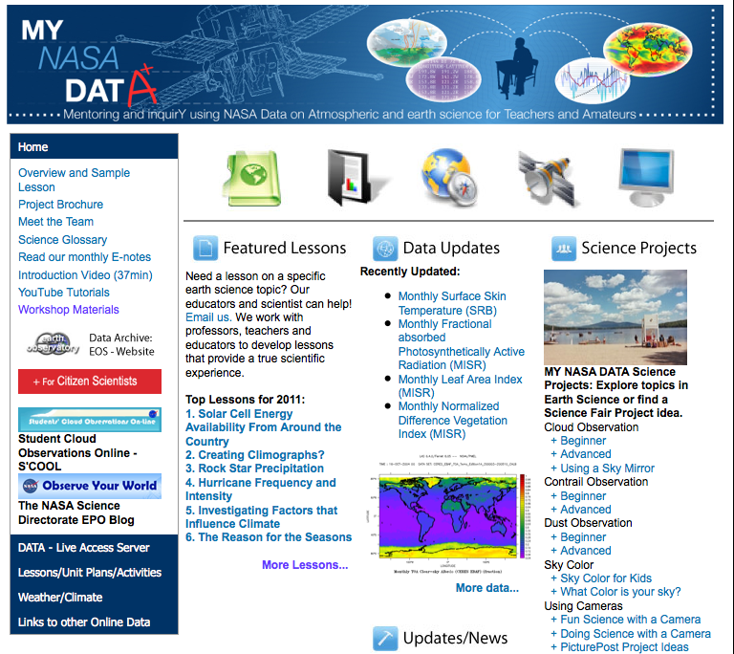

Slide 40
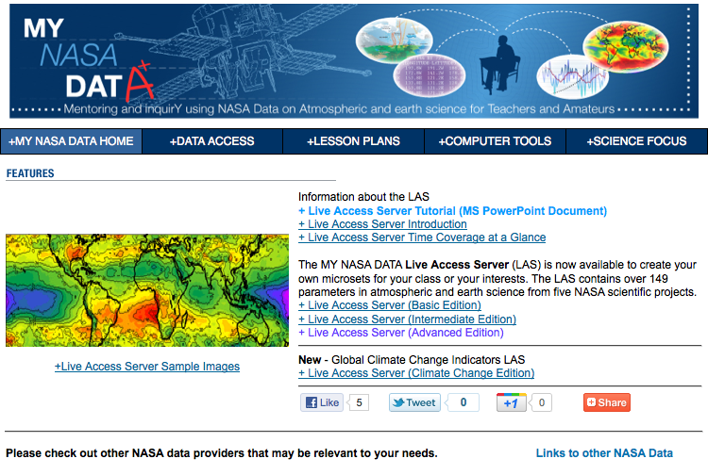

Slide 41
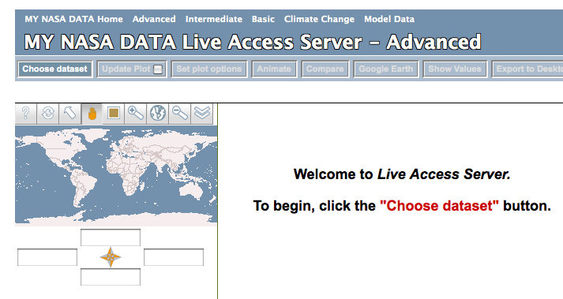

Slide 42

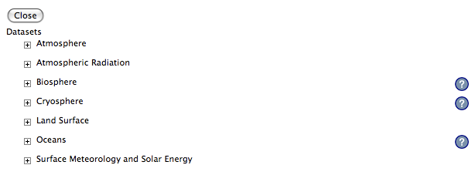

Slide 44
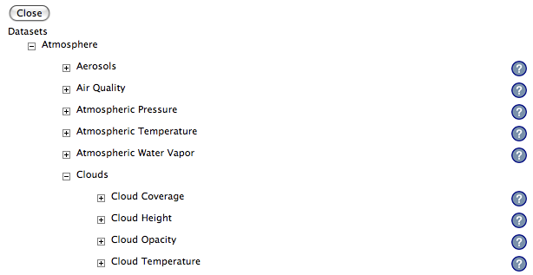

Slide 46
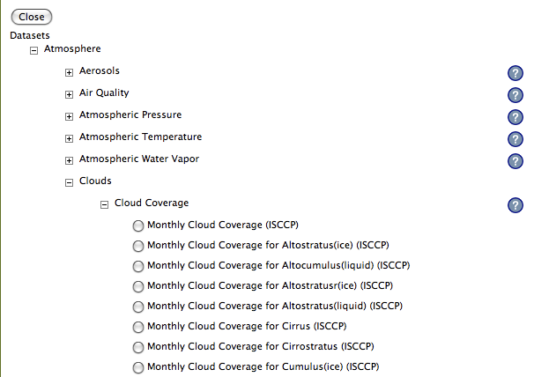

Slide 48
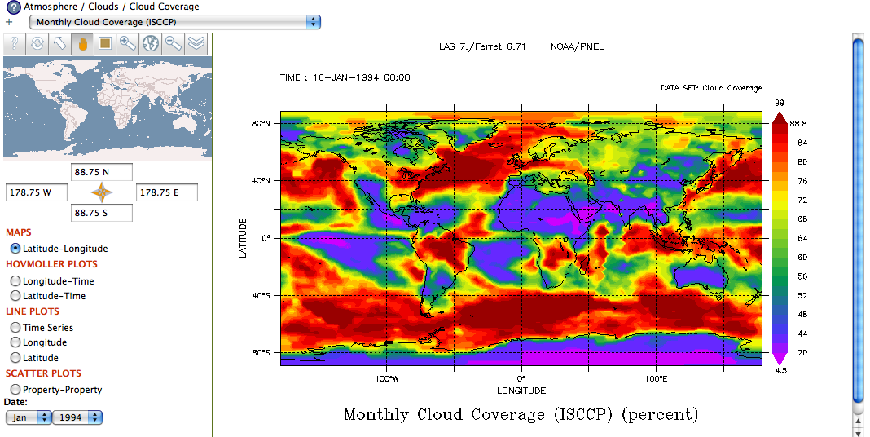

Slide 49

Thanks For Your Time!

