Slide 1
Using Earth Science Data and Technology to Mitigate the Dangers of Airborne Volcanic Ash
AGU-NESTA Geophysical Information for Teachers (GIFT) Workshop
Volcanic
Ash Modeling
via Puff
Peter Webley
Geophysical Institute, UAF

Slide 2
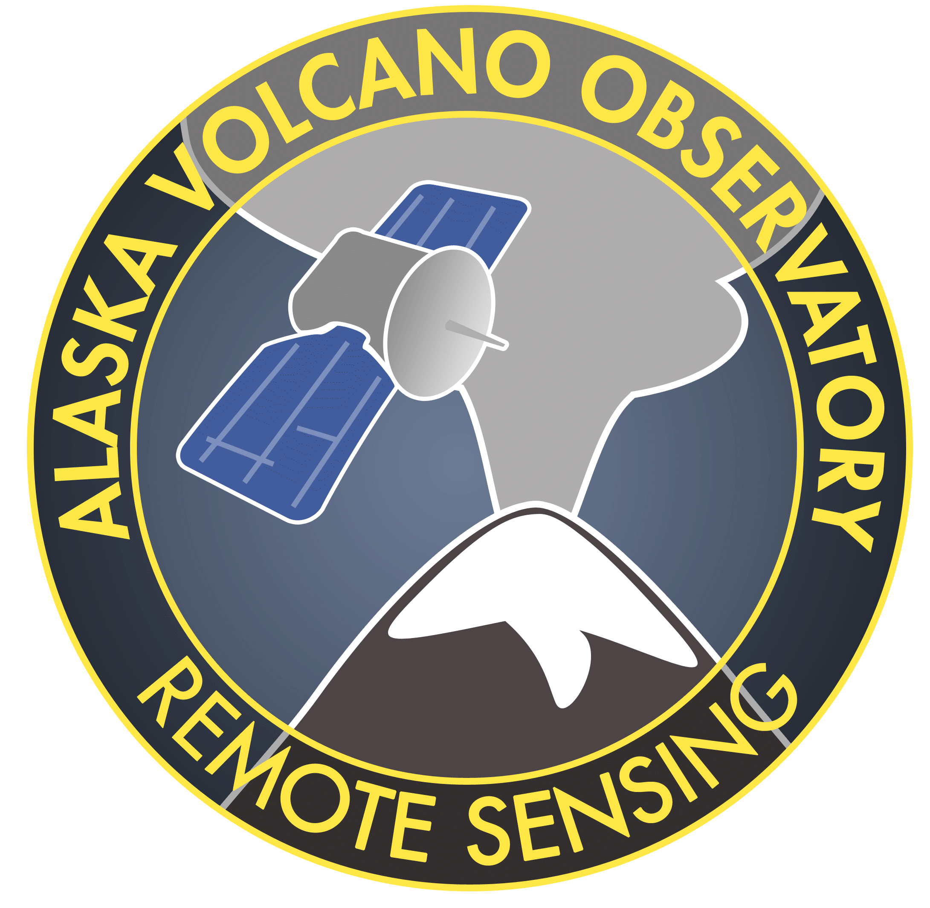
Plumes and Clouds we need to model

Slide 3
Why model volcanic ash clouds?
Volcanic ash is one of the major potential hazards from volcanic eruptions
Prior to a volcanic eruption, models are invaluable in predicting the movement of volcanic ash clouds and to ensure aviation safety
Until visual or ground observations are available, Volcanic Ash dispersion models provide the best quantative means to predict the ash cloud trajectory

Slide 4
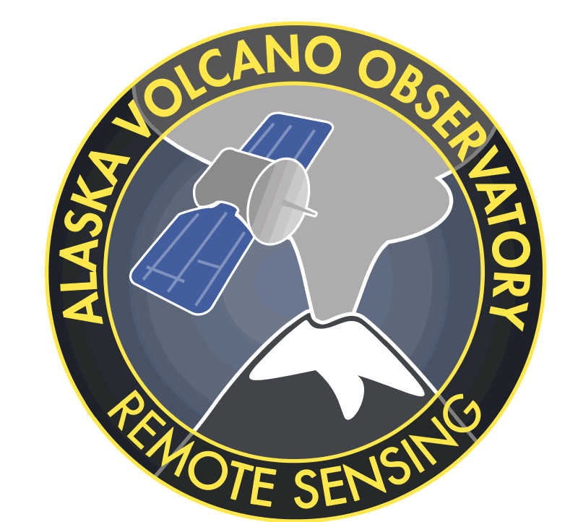
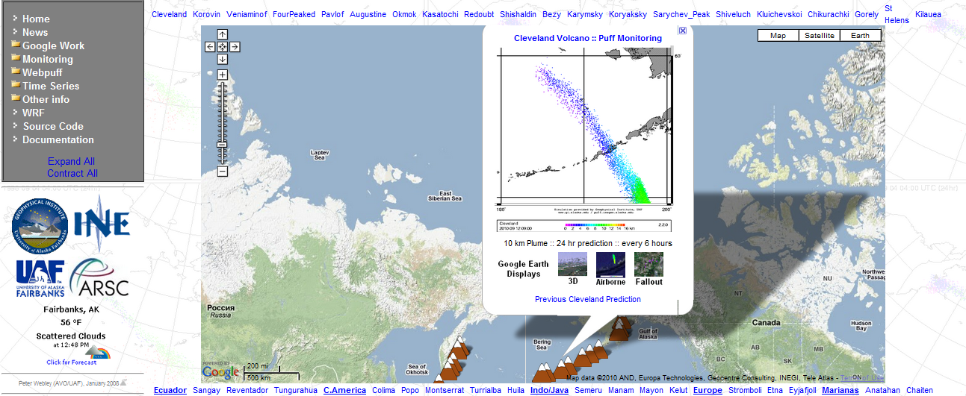
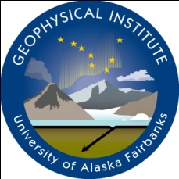
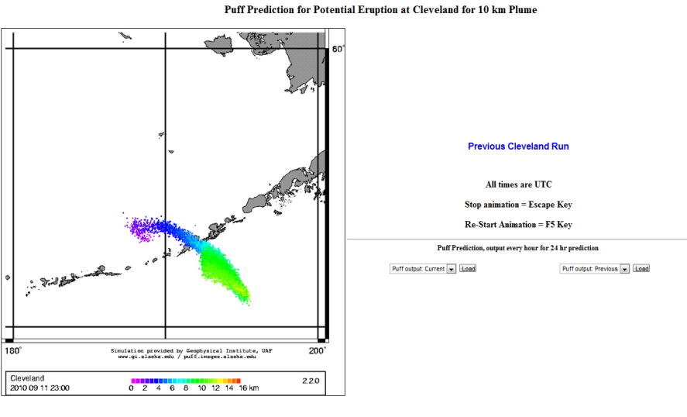
Puff – Volcanic Ash Tracking and Dispersion model http://puff.images.alaska.edu
Cleveland - NRT
Automated forecasts for 37 volcanoes worldwide
Forecasts for initial plumes from 4 – 16 km ASL
24 hour forecasts, updated every 3 – 6 hours
Standardized displays to reduce hazard assessment time
Two-dimensional and Three-dimensional visualizations
NWP vertical profiles to assist plume height determination

Slide 5
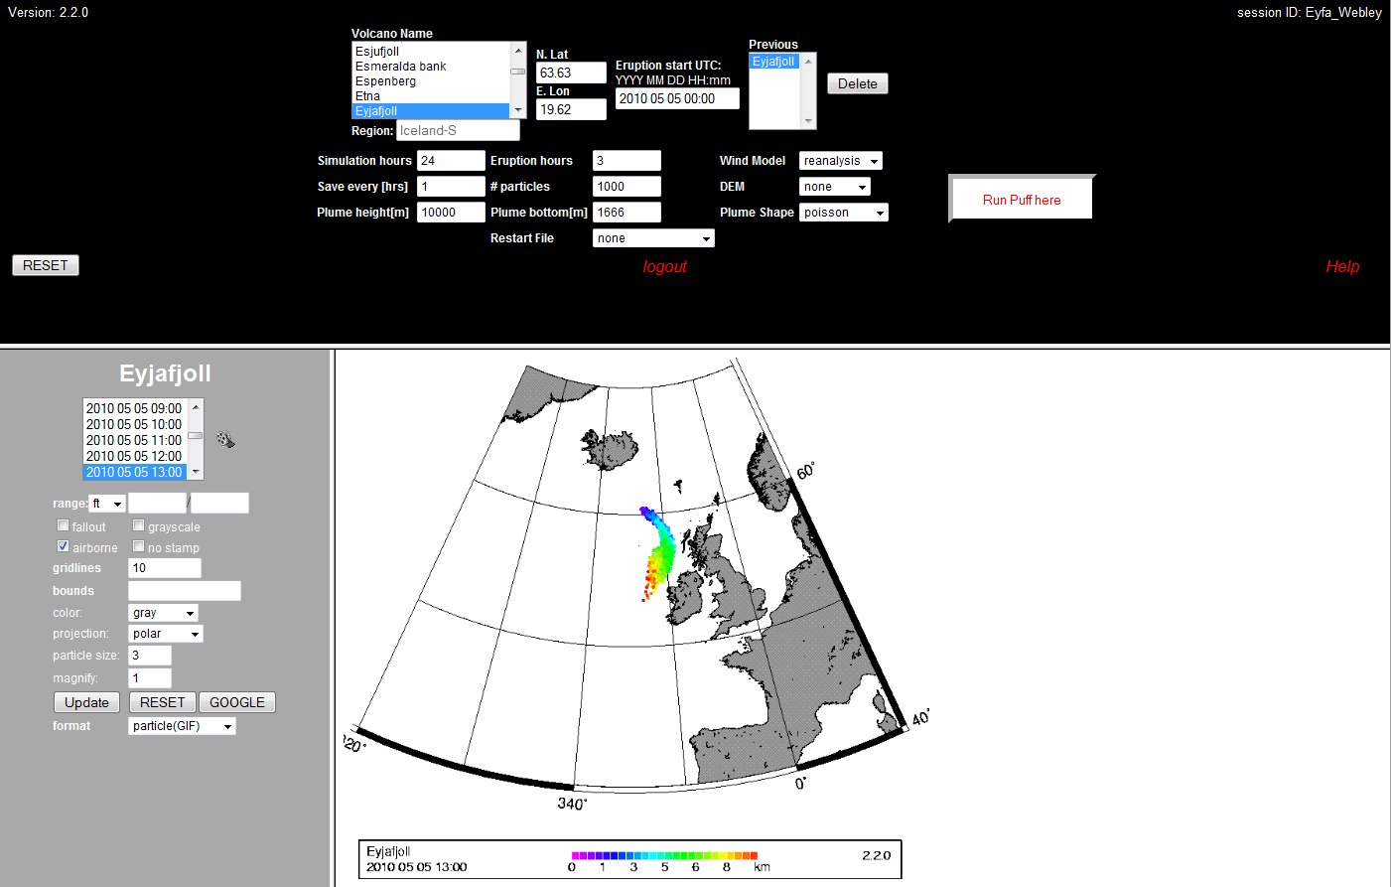
Online WebPuff http://puff.images.alaska.edu/cgi-bin/login_agu.pl
2. Set start time
1. Choose Volcano
3. Set input
parameters
4. Run model
5. View time series
Run for any volcano worldwide in real time or retrospectively from 1970 – present

Slide 6
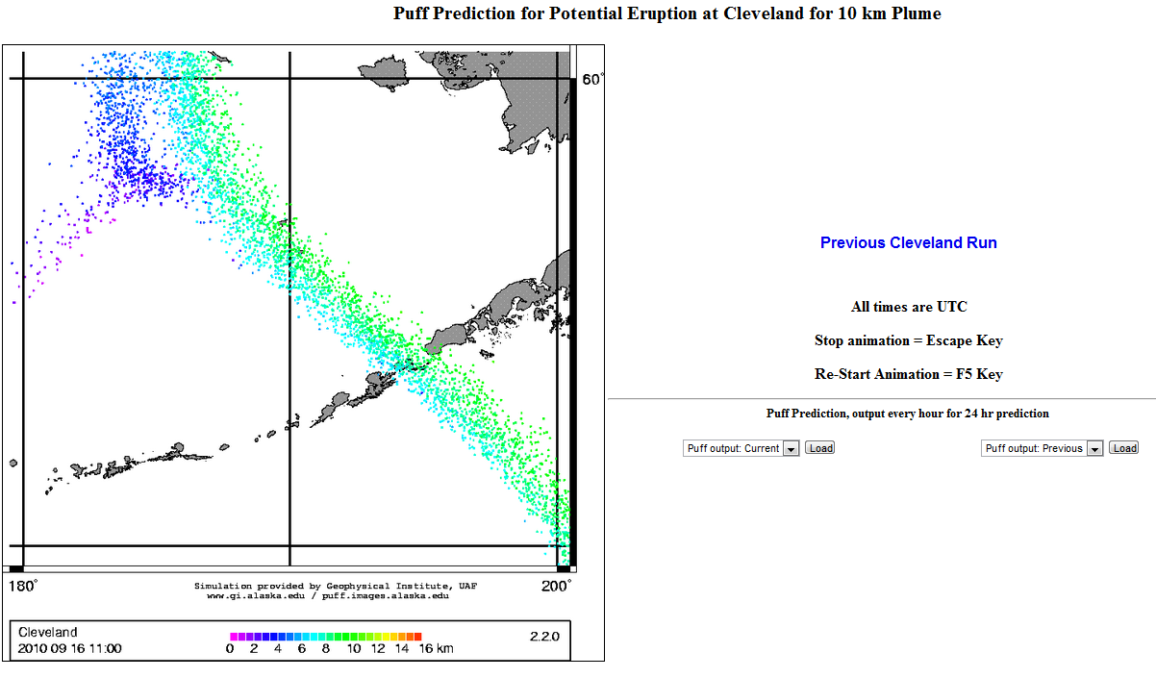
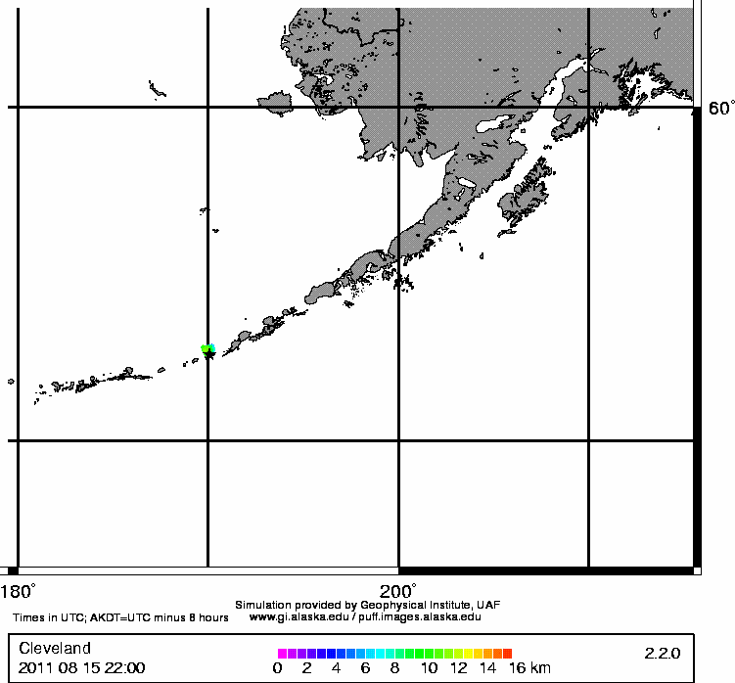
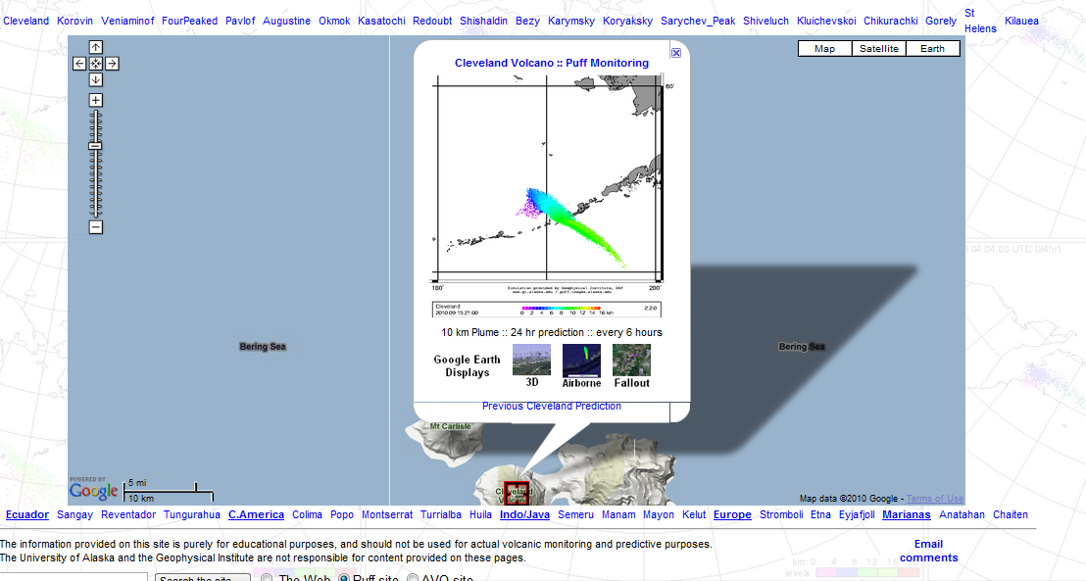
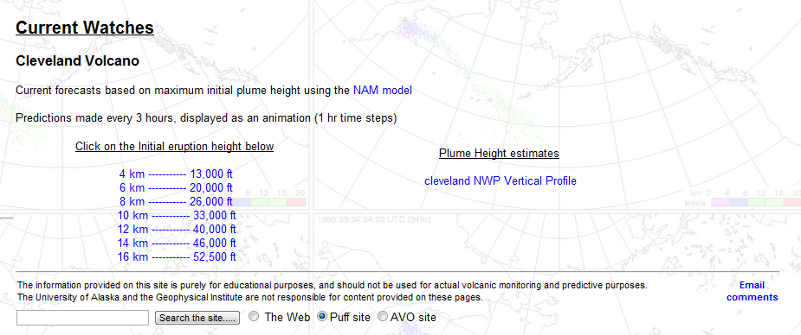
Cleveland, Alaska

Slide 7
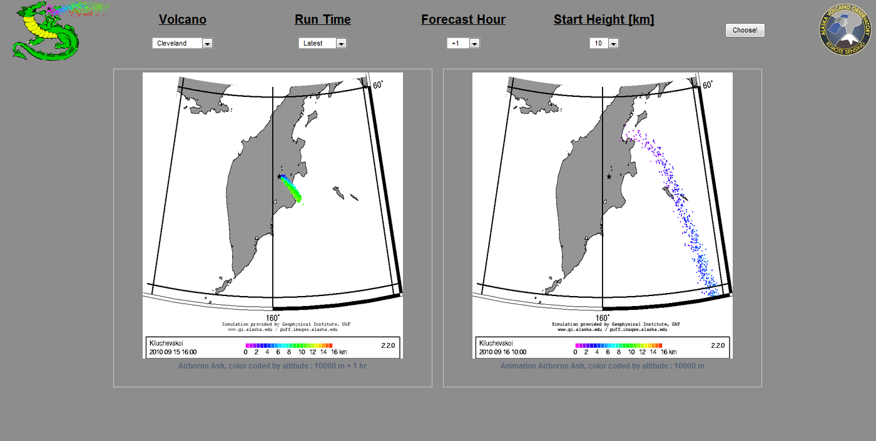
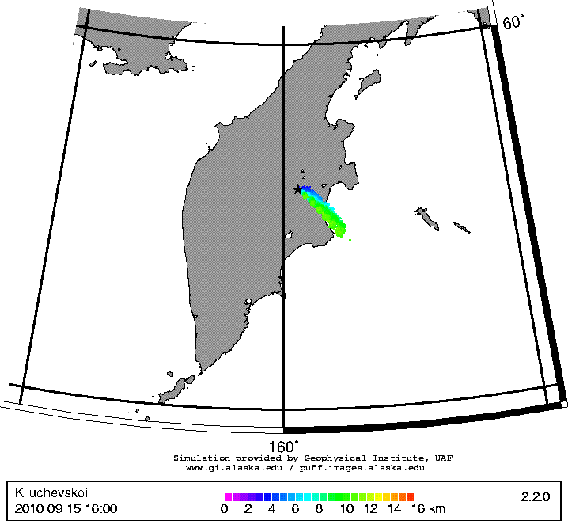
Auto forecasts page
http://puff.images.alaska.edu/auto_forecasts.php

Slide 8
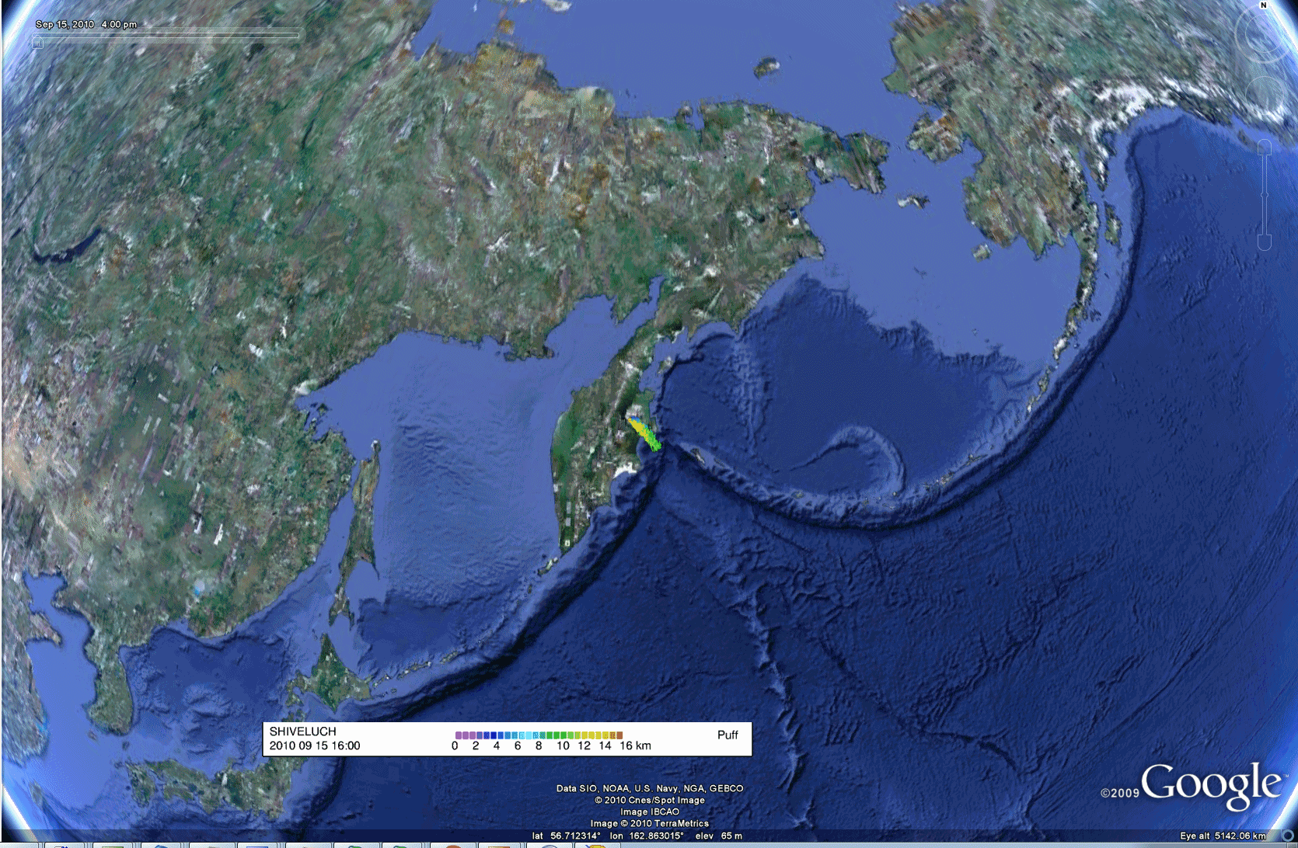
Auto Puff in Google 2D

Slide 9
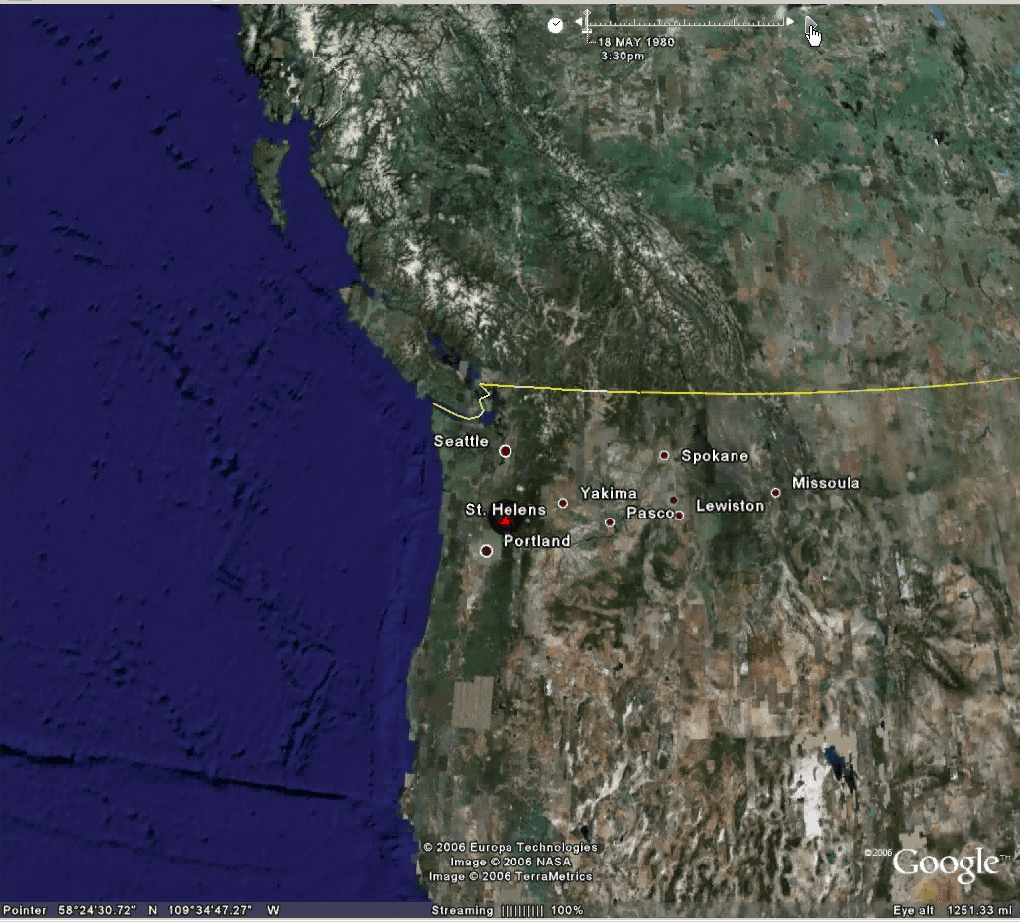
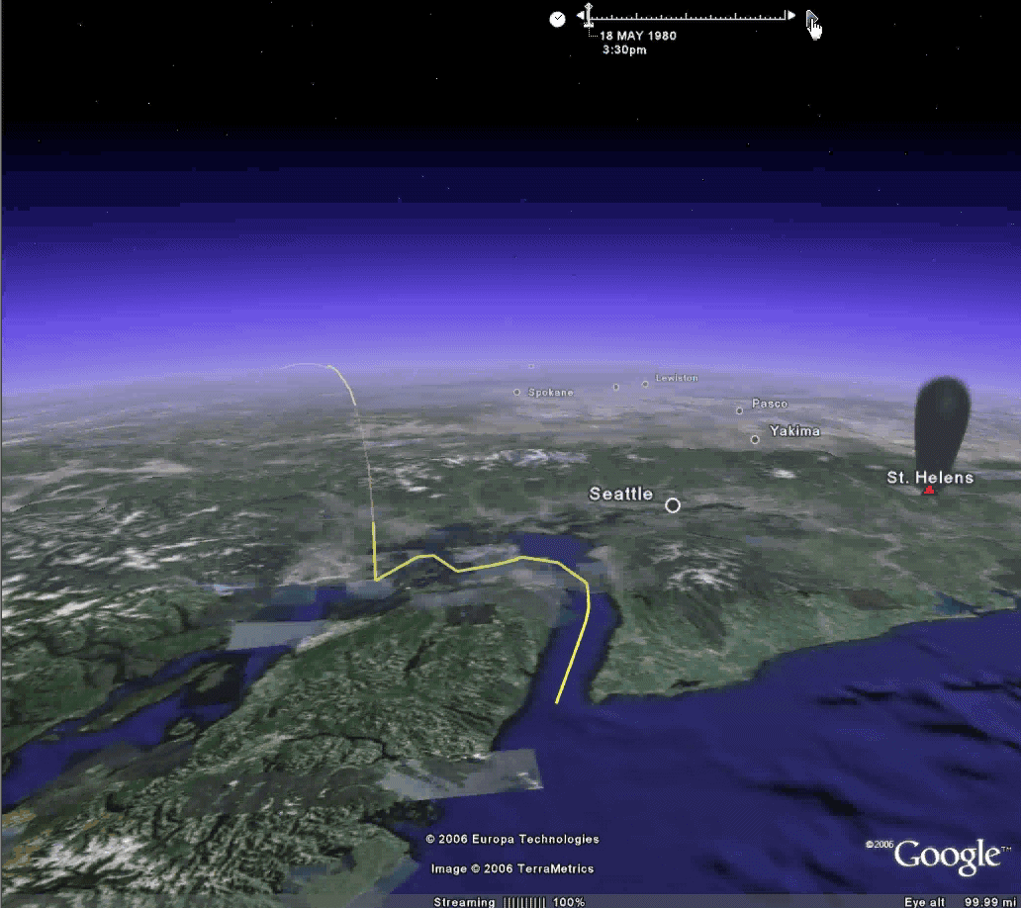
Mount St. Helens 1980

Slide 10
Composite map of ash clouds from 1970 – 2010 : + 12 hrs
Total : 383 separate ash clouds reaching > 6 km or 20,000 ft ASL

Slide 11
Volcanic Ash Clouds across North Pacific: 1970 - 2010
Total : 383 separate ash clouds reaching > 6 km or 20,000 ft ASL

